Slide 1

Capstone Project : Car accident severity
Vimmi Seth

Slide 2
Introduction | Business Understanding cont.
Background
Road traffic are becoming one of the leading causes of death across all age groups globally. Analyzing a significant range of factors, including weather conditions, special events, roadworks, traffic jams among others, an accurate prediction of the severity of the accidents can be performed.
These insights will allow law enforcement bodies to allocate their resources more effectively in advance of potential accidents, preventing when and where a severe accidents can occur as well as saving both, time and money. In addition, this knowledge of a severe accident situation can be warned to drivers so that they would drive more carefully or even change their route if it is possible or to hospital which could have set everything ready for a severe intervention in advance.

Slide 3
Introduction | Business Understanding cont.
Problem Description
In an effort to reduce the frequency of car collisions in a community, an algorithm must be developed to predict the severity of an accident given the current weather, road and visibility conditions. When conditions are bad, this model will alert drivers to remind them to be more careful
Target Audience
Governments should be highly interested in accurate predictions of the severity of an accident, in order to reduce the time of arrival and thus save a significant amount of people each year.
The public especially the travelers to a city would also be interested in accurate predictions of the severity of an accident under current conditions.

Slide 4
Data cont.
Data Understanding
For this project I’ll use data collected by “SDOT Traffic Management Division, Traffic Records Group”, in “Data_Collision.csv”. The data contains all types of collisions provided by SPD and recorded by Traffic Records from Timeframe: 2004 to Present.

Slide 5
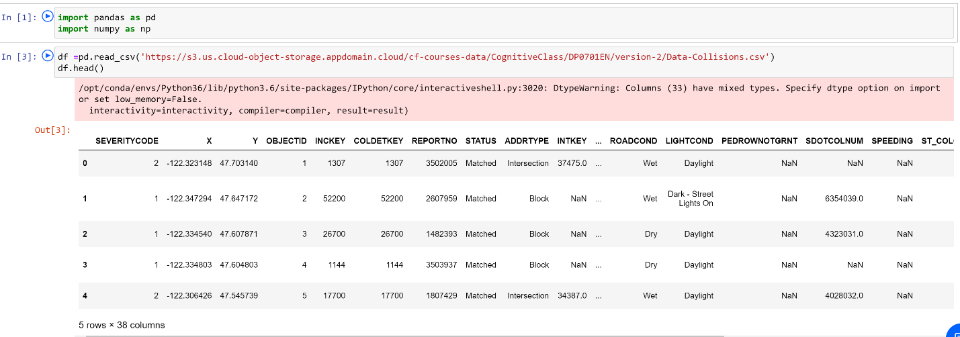
Data cont.
Data Understanding

Slide 6
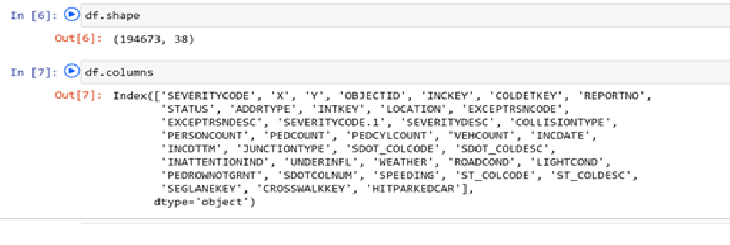
Data cont.
Data Understanding
This dataset contains 194674 rows and 38 columns with most of the information that will be needed for the project such as current weather, road and visibility conditions.

Slide 7
Data cont.
Data Understanding
Our predictor or target variable will be 'SEVERITYCODE' because it is used measure the severity of an accident in 5 levels [0,1,2,2b,3] within the dataset.
Severity codes are as follows:
Severity Code | Severity Description
3 | fatality
2b | serious injury
2 | injury
1 | prop damage
0 | unknown
Attributes used to weigh the severity of an accident are ‘'WEATHER', 'ROADCOND' and 'LIGHTCOND'.

Slide 8
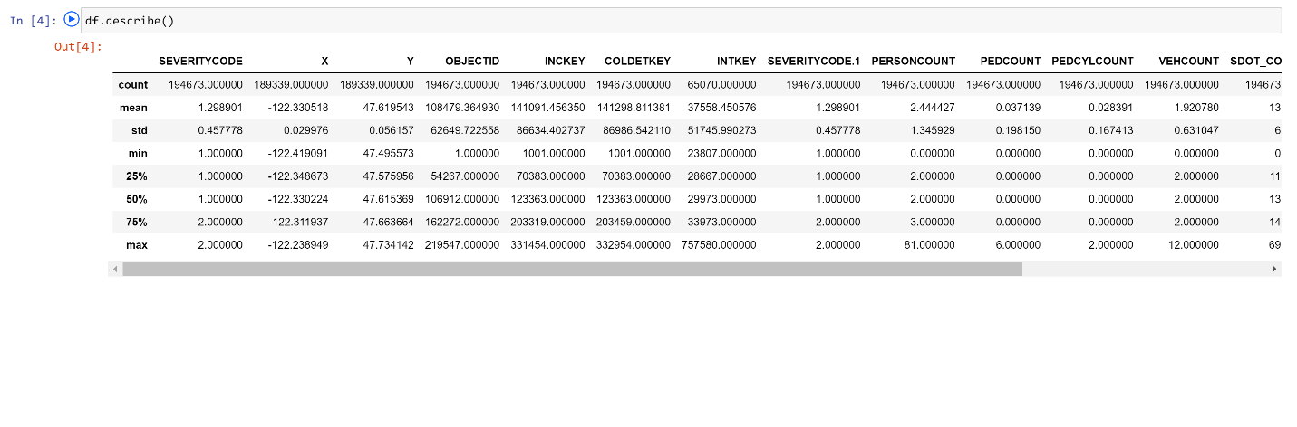
Data cont.
Data Preparation and Cleaning
However, this dataset contains mixed datatypes and needs extensive cleaning before it can be used for the project.

Slide 9
Data cont.
Data Preparation and Cleaning
Select data that is related to our problem
Remove unnecessary data [Drop these columns]
Remove the rows with null values.
Do data profiling to validate correctness of data.
Convert columns with text field to numerical data like categorizing the weather conditions
Eliminated rows that greatly contributed to the imbalance of the data and were not significant in volume
Replaced null values with fillers.

Slide 10
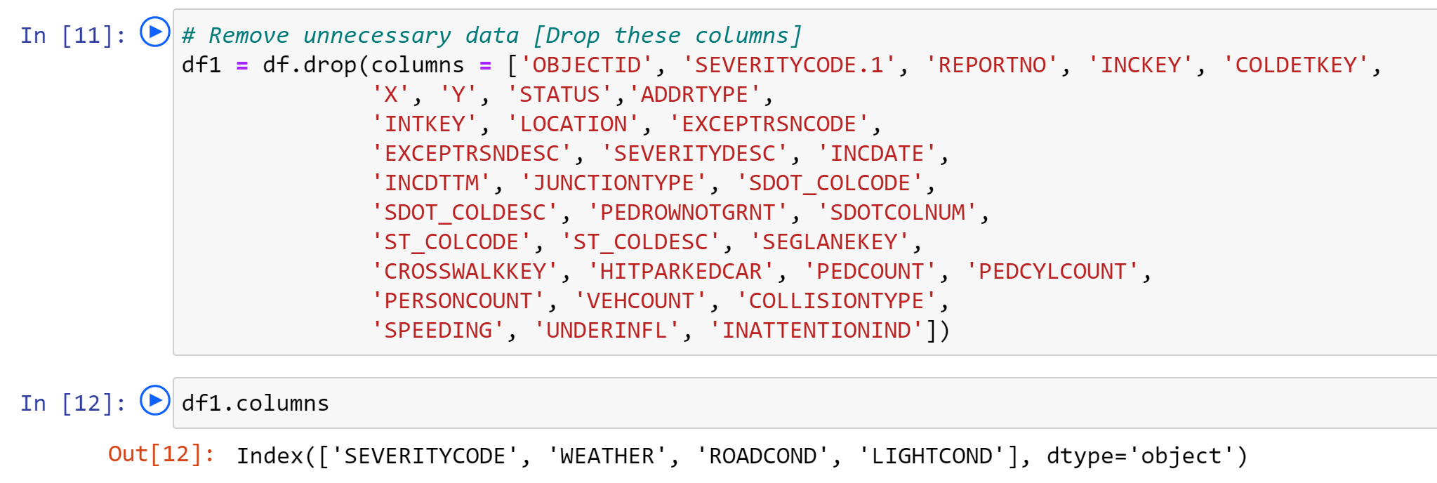
Data cont.
Data Preparation and Cleaning
Remove unnecessary data [Drop these columns].

Slide 11
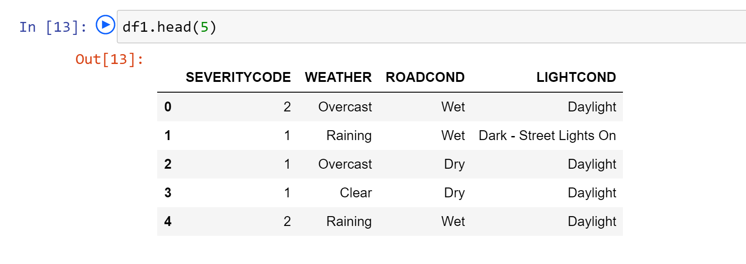
Data cont.
Data Preparation and Cleaning
Select data that is related to our problem.

Slide 12
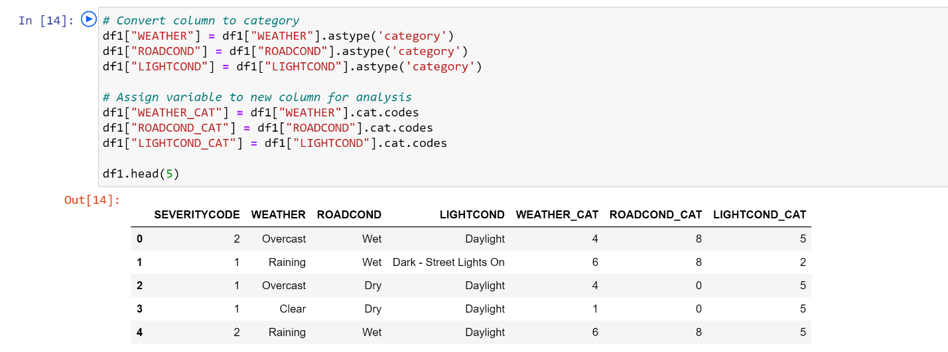
Data cont.
Data Preparation and Cleaning
Convert columns with text field to numerical data like categorizing the weather conditions.

Slide 13
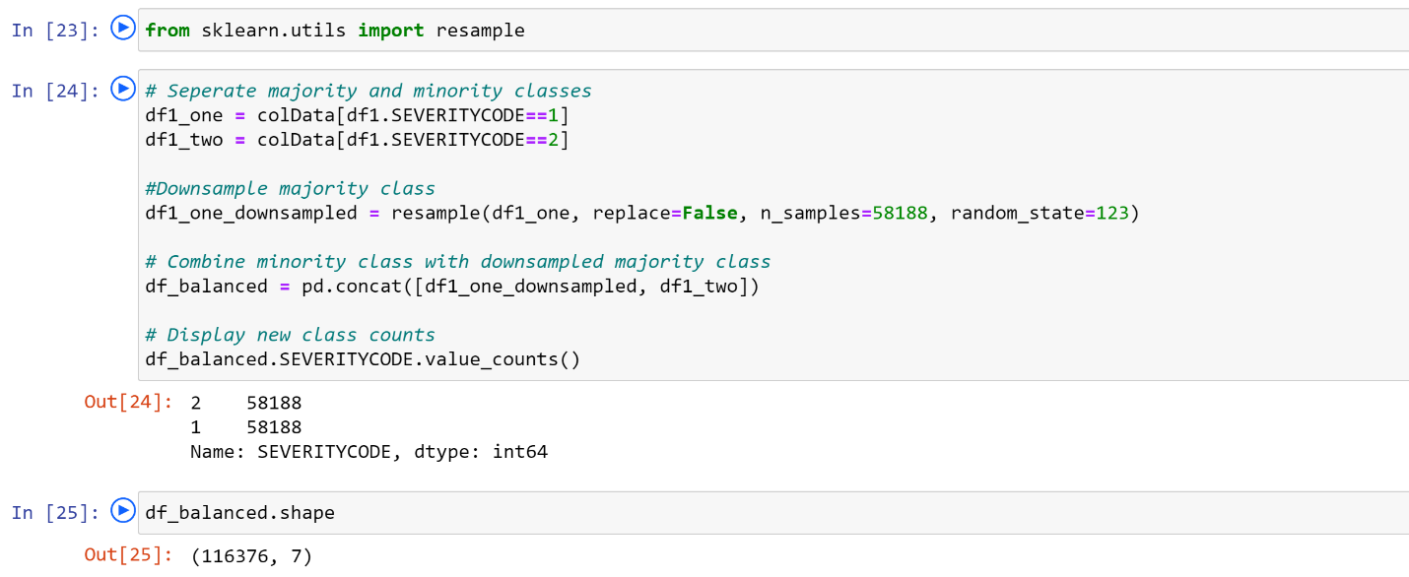
Data cont.
Data Preparation and Cleaning
Eliminated rows that greatly contributed to the imbalance of the data by downscaling.

Slide 14
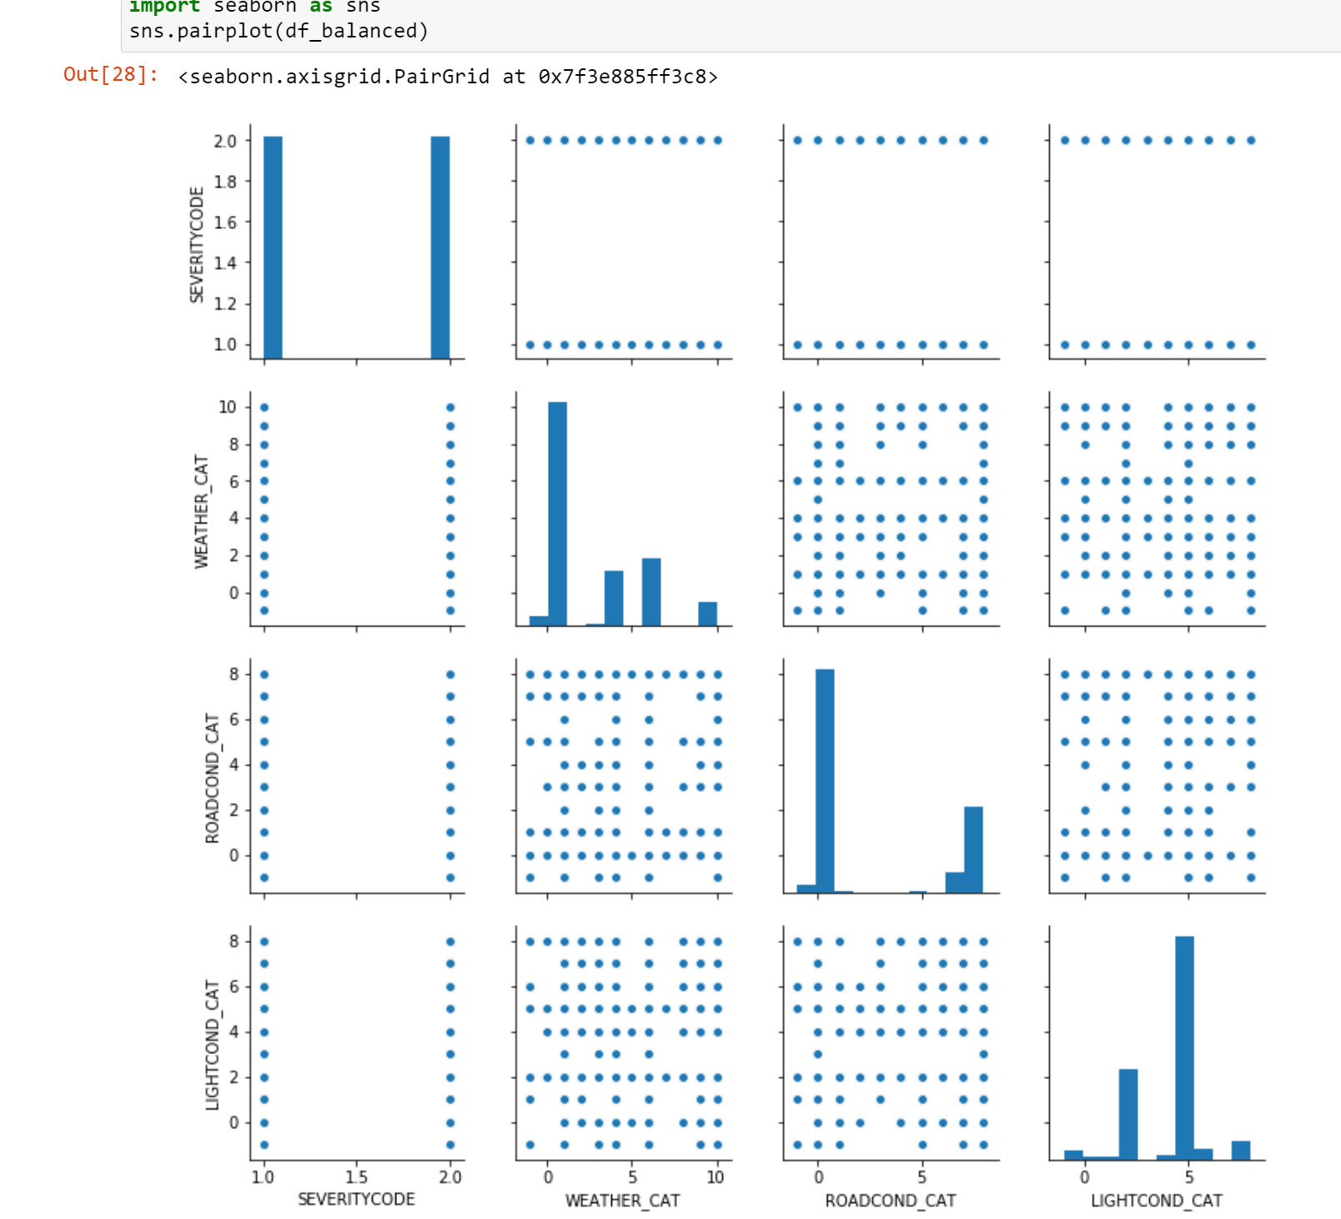
Data cont.
Exploratory Data Analysis

Slide 15
Predictive Modeling cont.
K-Nearest Neighbor (KNN): KNN will help us predict the severity code of an outcome by finding the most similar to data point within k distance.
Decision Tree: A decision tree model gives us a layout of all possible outcomes so we can fully analyze the consequences of a decision. It context, the decision tree observes all possible outcomes of different weather conditions.
Random Forest: A random forest fits a number of decision tree classifiers on various sub-samples of the dataset and uses averaging to improve the predictive accuracy and control over-fitting. The number of decision trees is specified with the n_estimators parameter.
Logistic Regression: Because our dataset only provides us with two severity code outcomes, our model will only predict one of those two classes. This makes our data binary, which is perfect to use with logistic regression.

Slide 16
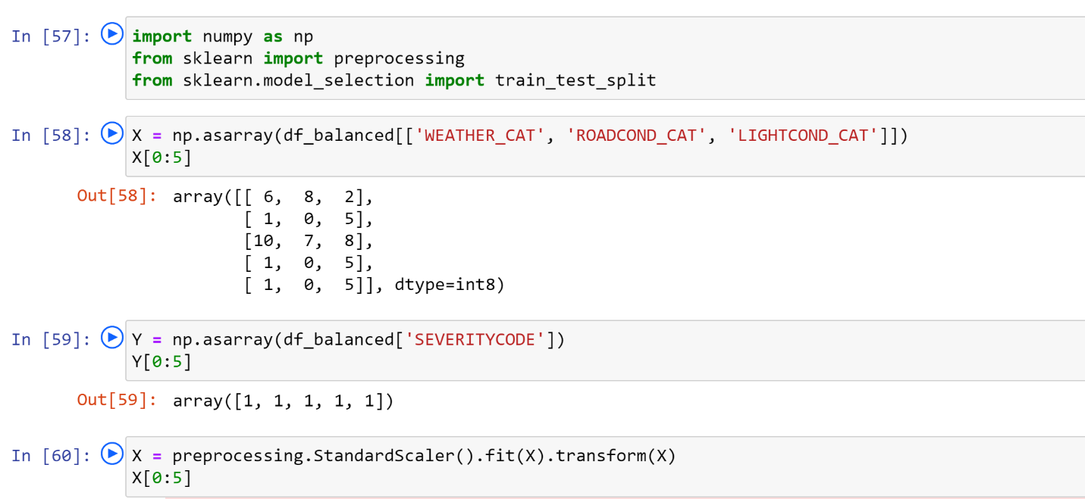
Predictive Modeling cont.
Defining X and Y.

Slide 17
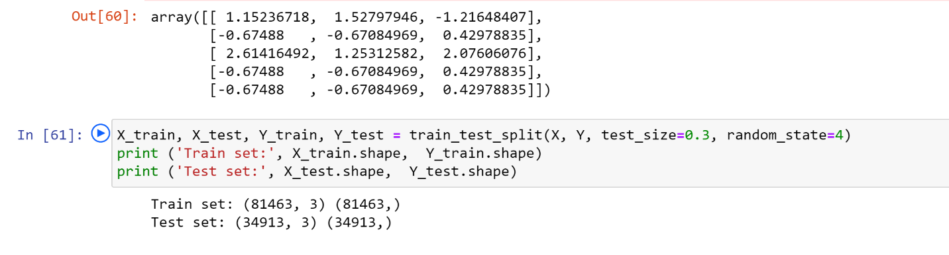
Predictive Modeling cont.
Defining X and Y.

Slide 18
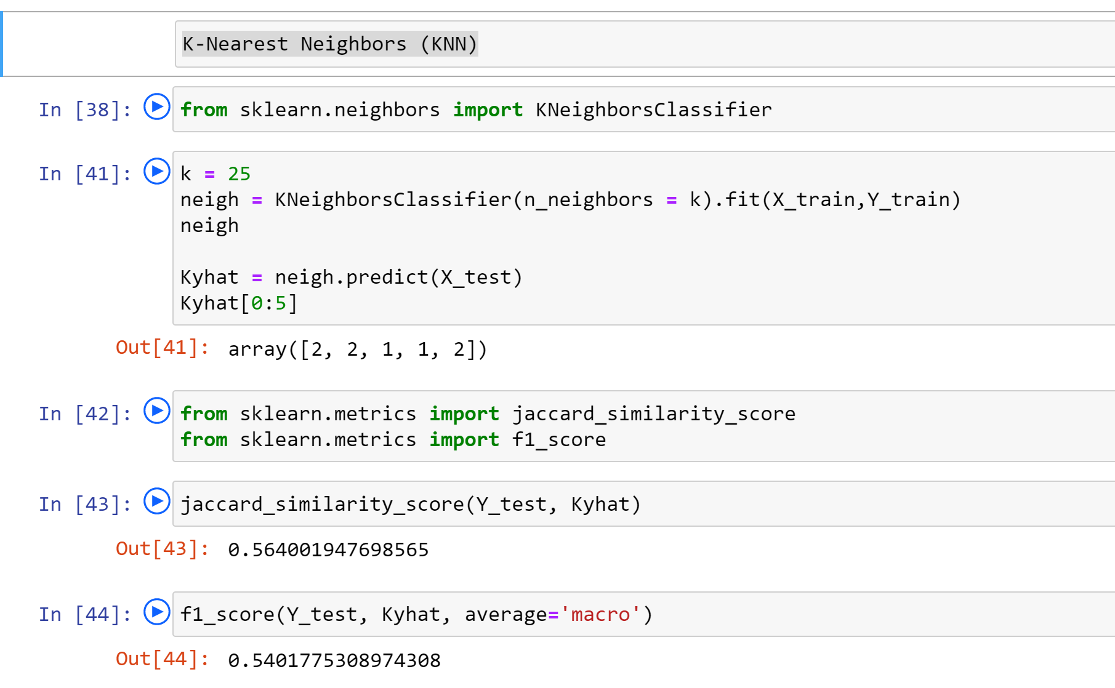
Predictive Modeling cont.

Slide 19
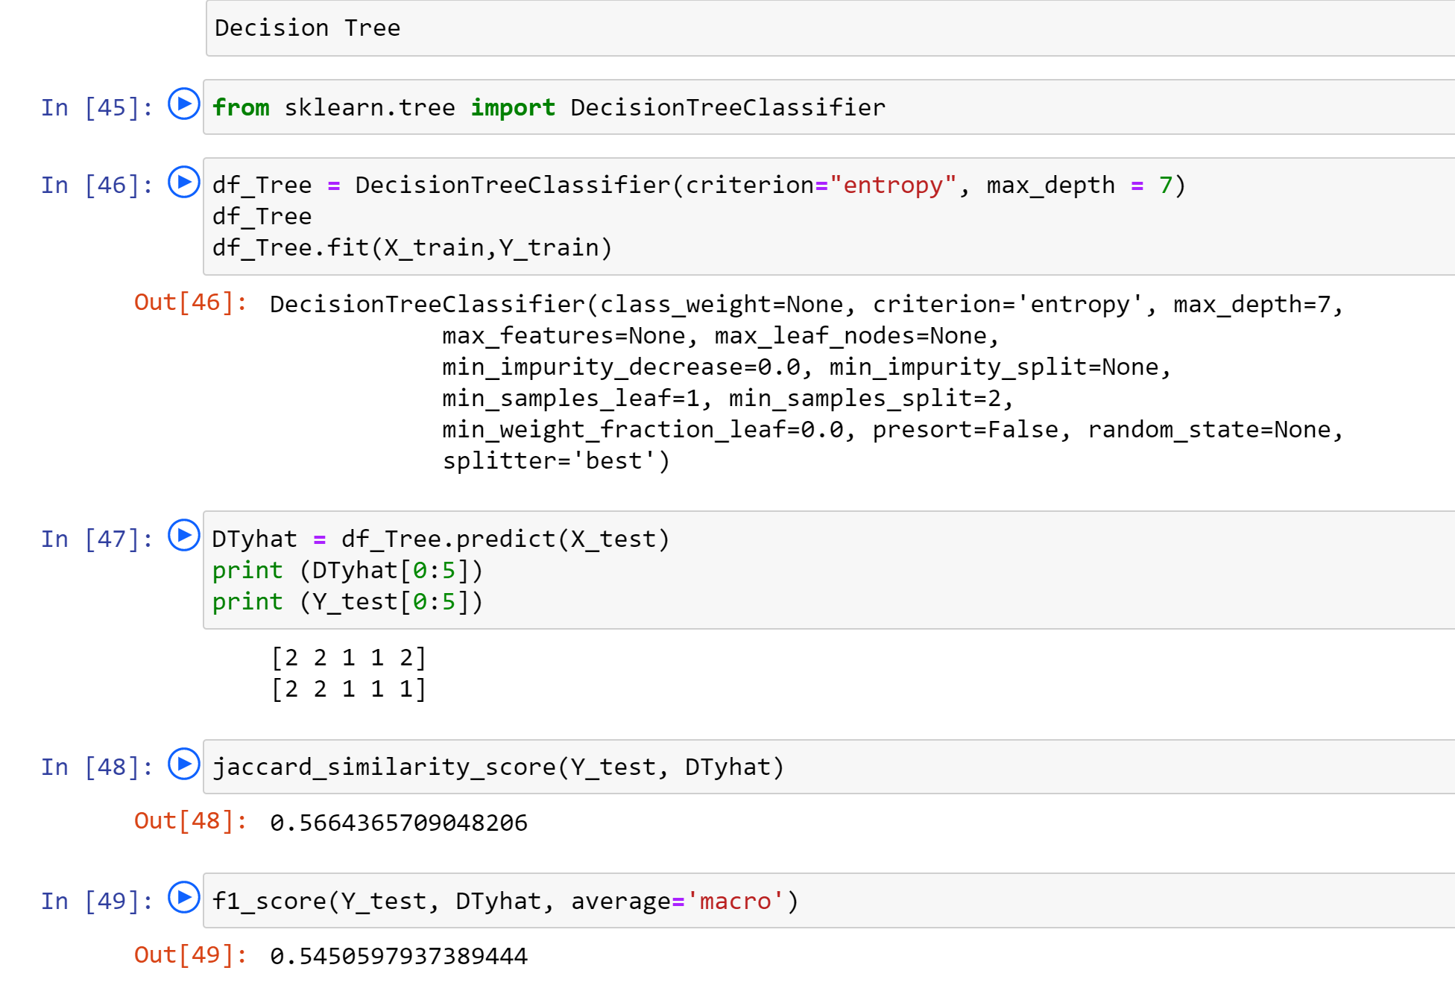
Predictive Modeling cont.

Slide 20
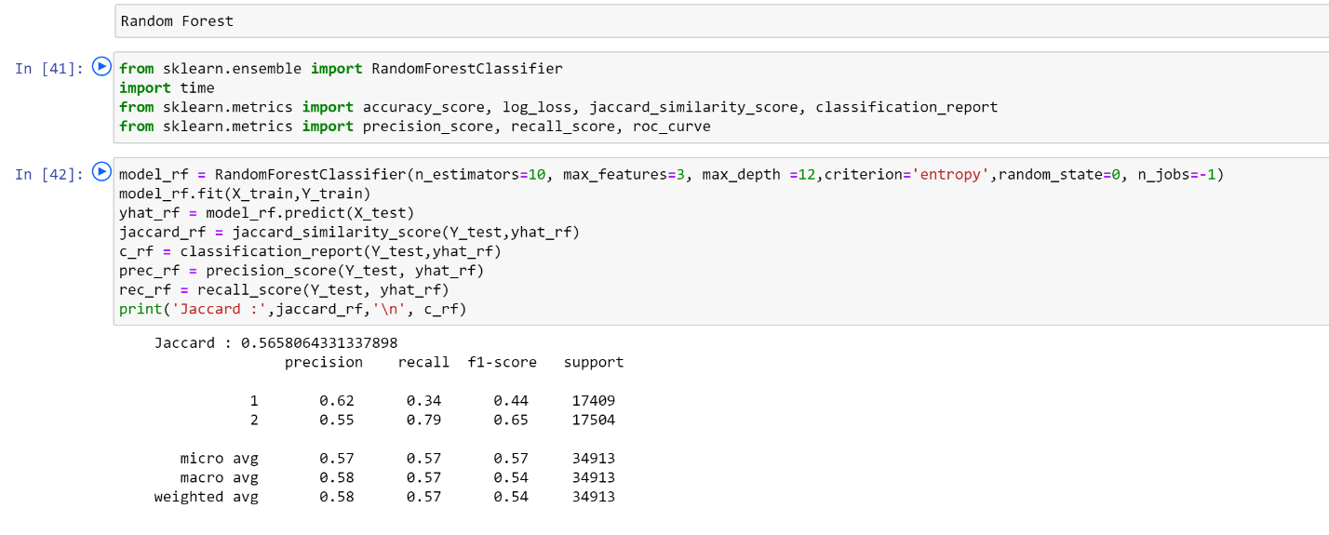
Predictive Modeling cont.

Slide 21
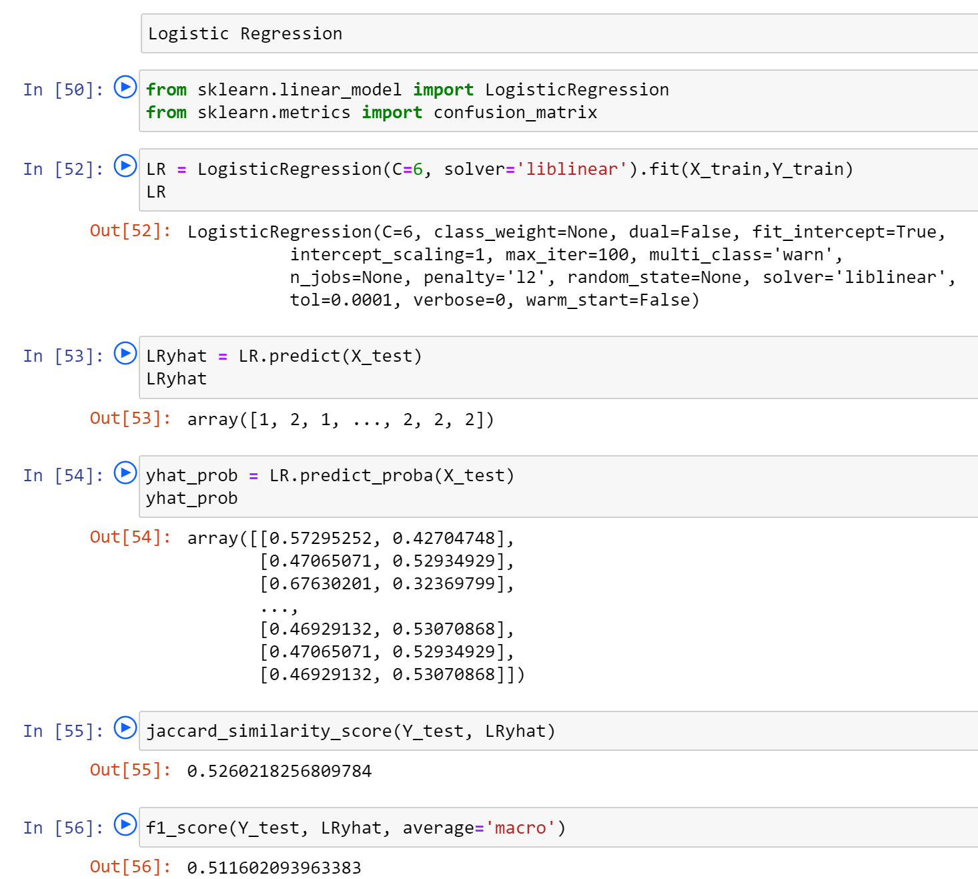
Predictive Modeling cont.

Slide 22
Result
Algorithm | Jaccard | f1-score
K-Nearest Neighbor | 0.564 | 0.540
Decision Tree | 0.566 | 0.545
Random Forest | 0.659 | 0.565
Logistic Regression | 0.526 | 0.511
Random Forest is the best model.

Slide 23
Discussion
After uploading data from the provided data [csv file ] successfully, we determined the attributes (columns) that we will use to train your machine learning model.
We cleaned the data by dropping the columns containing unrelated data.
Data of type 'object' could be fed through an algorithm, so label encoding was used to created new classes that were of type int8; a numerical data type. We mapped the categorical data that was of type 'object' to int8.
Next issue identified with data was - imbalanced data. Class 1 of SEVERITYCODE was nearly three times larger than class 2. The solution to this was downsampling the majority class. We used sklearn's resample tool to downsample the data to match the minority class exactly with 58188 values each.
Once we analyzed and cleaned the data, it was then fed through four ML models; K-Nearest Neighbor, Decision Tree, Random Forest and Logistic Regression. Evaluation metrics used to test the accuracy of our models were jaccard index, f-1 score and logloss for logistic regression. Choosing different k, max depth and hyperamater C values helped to improve our accuracy to be the best possible.

Slide 24
Conclusion
I analyzed the relationship between severity of an accident and other factors such as weather condition, road condition and light condition from data collected from Traffic Records. I used 4 different classification models to study & predict whether an accident would have a high or low severity ijn certain conditions.
Considering Jaccard value = 0.659 and f1-score = 0.565, Random Forest is the most suitable model for this scenario.
These models can have an important application in real life such as, predicting the Severity of an accident in real time, so that corrective measures can be taken in time to avoid them.

Slide 25
Thank you

